Slide 1










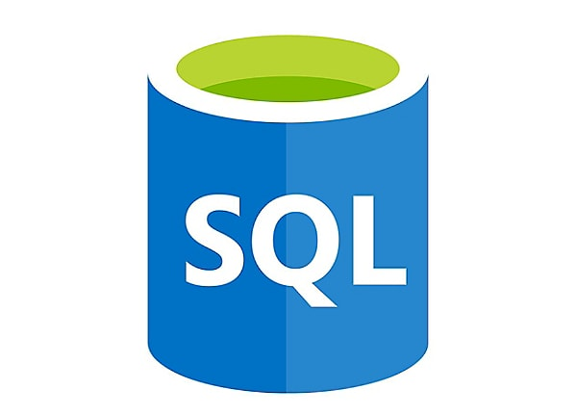

$subscriptionId
da-dev-resource-kv.deploy.ps1
CreateAzureServicePrincipalsAndCreds.ps1
Execution Order
$resourceName
1. Set In Azure
$localroot
$VaultName
2. da-dev-resource-kv.deploy.ps1
3. CreateAzureServicePrincipalsAndCreds.ps1
4. da-dev-resource-dl.deploy.ps1
5. CreateDatabricksSecretsCLI_option2.ps1
6. ConfigureAzureKeyVault.ps1
7. SetADLSPermissionsContainerDev.ps1
8. da-dev-resource-dl.deploy.ps1
9. da-dev-resource-fw-db.ps1
10. da-dev-resource-db.deployment.ps1
Set Keys
CreateDatabricksSecretsCLI_option2.ps1
$Azure AD Groups
$Azure App Registration
ConfigureAzureKeyVault.ps1
da-dev-resource-dl.deploy.ps1
Set Permissions
SetADLSPermissionsContainerDev.ps1
da-dev-resource-fw-db.ps1
$ContainerName
da-dev-resource-dl.deploy.ps1
$resourceName
$serverName
Access-Token
Arm_template
Arm_template_parameters
Load Notebooks
ImportDatabricksFolder.ps1
Linked Service
da-dev-resource-db.deployment.ps1
Linked Service
$Resourcename
Linked Service

